Slide 1

The Analytic Network Process (ANP)
for Decision Making and Forecasting
with Dependence and Feedback
With feedback the alternatives depend on the criteria as
in a hierarchy but may also depend on each other.
The criteria themselves can depend on the alternatives
and on each other as well.
Feedback improves the priorities derived from judgments
and makes prediction much more accurate.

Slide 2
Linear Hierarchy
Goal
Criteria
component,
cluster
(Level)
Subcriteria
element
Alternatives
A loop indicates that each
element depends only on itself.

Slide 3
Feedback Network with components having
Inner and Outer Dependence among Their Elements
Arc from component
C₄ to C₂ indicates the
outer dependence of the
elements in C₂ on the
elements in C₄ with respect
to a common property.
C₄
C₁
C₂
Feedback
C₃
Loop in a component indicates inner dependence of the elements in that component
with respect to a common property.

Slide 4
Inner and Outer Dependence
and the Control Hierarchy
In a network, the elements in a component may be people (e.g., individuals in the White House) and those in another component may also be people (e.g., individuals in Congress).
The elements in a component may influence other elements in the same component
(inner dependence) and those in other components (outer dependence) with respect to each of several properties. We want to determine the overall influence of all the elements.
In that case we must organize the properties or criteria and prioritize them in the framework of a control hierarchy (or a network), perform comparisons and synthesize to obtain the priorities of these properties. We then derive the influence of elements in the feedback system with respect to each of these properties. Finally, we weight the resulting influences by the importance of the properties and add to obtain the overall influence of each element.

Slide 5
Main Operations of the ANP
Relative measurement: Reciprocal relation
Judgments: Homogeneity
Hierarchy or Network: Structure of problem; the control hierarchy
Priorities, Dominance and Consistency: Eigenvector
Composition, Additive to also handle dependence through the supermatrix
Supermatrix: Dependence
Neural Firing: Fredholm Kernel and Eigenfunctions

Slide 6
Inner and Outer Dependence
and the Control Hierarchy cont.
Control hierarchies fall in four groups:
Benefits, Costs, Risks, & Opportunities.
Benefits and costs measure the positive and negative contributions or importance of the alternatives if they happen, but will they happen?
Risks and opportunities measure the likelihood that the alternatives will happen and make positive and respectively negative contributions.
Each one is a hierarchy (or a network) by itself. The overall priorities of the
alternatives with respect to each of these are then combined by forming the ratios:
to obtain their final overall priorities for a decision.
Benefits x Opportunities
Costs x Risks

Slide 7
Weighting The Components
In the ANP one often needs to prioritize the influence of the components themselves on each other component to which the elements belong. This influence is assessed through paired comparisons with respect to
a control criterion.
The priority of each component is used to weight the priorities of all the elements in that component. The reason for doing this is to enable us to perform feedback multiplication of priorities by other priorities in a cycle, an infinite number of times. The process would not converge unless the resulting matrix of priorities is column stochastic (each of its columns adds to one).
To see that one must compare clusters in real life, we note that if a person is introduced as the president it makes much difference, for example, whether he or she is the President of the United States or the president of a local labor group.

Slide 8
Functional - Structural Criteria
Independence - Dependence
1--Criteria completely independent from alternatives - Absolute
Measurement, Intensities and Standards.
2--Criteria quasi dependent on alternatives - Relative Measurement: Rescale the weight of a criterion by the number of alternatives and their measurement (normalization).
3--Criteria completely dependent on alternatives - Feedback network - the Supermatrix.

Slide 9
Why ANP?
The power of the Analytic Network Process (ANP) lies in its use of
ratio scales to capture all kinds of interactions and make accurate predictions, and, even further, to make better decisions. So far, it has proven itself to be a success when expert knowledge is used with it to predict sports outcomes, economic turns, business, social and political decision outcomes.
The ANP is a mathematical theory that makes it possible for one to deal systematically with all kinds of dependence and feedback. The reason for its success is the way it elicits judgments and uses measurement to derive ratio scales. Priorities as ratio scales are a fundamental kind of number amenable to performing the basic arithmetic operations of adding within the same scale and multiplying different scales meaningfully as required by the ANP.

Slide 10
Mutual Influence Among Several Elements
In order to distinguish among the influence of several homogeneous elements that is exerted on a single element, the number of influencing elements cannot be more than a few. The reason is that the element that is influenced must be able to distinguish between the various influences and respond to them in relatives terms. If their number is large, the relative influence of each would be a small part of the total. On the other hand, if the number of elements is small, the relative influence of each one on any other single element would be large and distinguishable. A small change in the influence of any of these elements would not alter the receiving elements estimation of its overall influence. When the number of elements is large, they need to be put in different clusters.
Unidirectional Influence
A single powerful element may influence numerous other elements that do not influence it in return or influence each other. If many elements influence a single element without feedback, their number can be arbitrarily large.

Slide 11
The Questions to Answer About the
Dominance of Influence
Two kinds of questions encountered in the ANP:
1. Given a criterion, which element has greater influence (is more dominant) with respect to that criterion?
Use one of the following two questions throughout an exercise.
2. Given a criterion and given an element X in any cluster, which element in the same cluster or a different cluster has greater influence on X with respect to that criterion?
2’. Given a criterion and given an element X in any cluster, which element in the same or in a different cluster is influenced more by X with respect to that criterion.

Slide 12
Example of Control Hierarchy
Optimum Function of A System
Environmental
Economic
Social
Influence is too general a concept and must be specified in terms of particular criteria. It is analyzed according to each criterion and then synthesized by weighting with these priorities of the “control” criteria belonging to a hierarchy or to a system.

Slide 13
The Supermatrix
Take a control criterion. The priorities of the elements derived from paired comparisons with respect to that control criterion are arranged both vertically and horizontally according to components. The elements in each component are listed for that component in a matrix known as the Supermatrix. Each vector taken from a paired comparison matrix is part of the column of the supermatrix representing the impact with respect to the control criterion of the elements of that component on a single element of the same or another component listed at the top.
The Weighted Supermatrix
All the clusters are pairwise compared according to their influence on a given cluster X with respect to the control criterion. This yields a vector of priorities of the impact of all the clusters on a given criterion. Each component of a vector is used to weight all the elements in the block of column priorities of the supermatrix corresponding to the impact of the elements of that cluster on X. The process is repeated for all the clusters resulting in a weighted supermatrix.
In each block of the supermatrix, a column is either a normalized eigenvector with possibly some zero entries, or all of its elements are equal to zero. In either case it is weighted by the priority of the corresponding cluster on the left. If it is zero, that column of the supermatrix must be normalized after weighting by the cluster’s weights. This operation is equivalent to assigning a zero value to the cluster on the left when weighting a column of a block with zero entries and then re-normalizing the weights of the remaining clusters.

Slide 14
The Limiting Supermatrix
The weighted supermatrix is now column stochastic from which one then derives the limiting supermatrix. There are four major cases to consider in deriving the limiting supermatrix depending on the simplicity or multiplicity of the principle eigenvalue and on the reducibility and irreducibility of the matrix.
How to Read Off the Answer
The desired priorities of the criteria and alternatives with respect to the corresponding control criterion can be read off the supermatrix as given or they may be structurally adjusted according to the number of elements in each cluster and appropriately re-weighted.
How to Combine Benefits, Costs, Opportunities, Risks
One must first combine the supermatrices for the benefits, then for the costs, then for the opportunities and then for the risks by using the weights of the control criteria for each. One then takes the ratio
benefits x opportunities / costs x risks
for the alternatives and selects the alternative with the largest ratio.

Slide 15
Networks and the Supermatrix
c₁ c₂ c_{N}
e₁₁e₁₂
e_{1n1}
e₂₁e₂₂
e_{2n2}
e_{N1}e_{N2}
e_{NnN}
c₁
c₂
c_{N}
e₁₁
e₁₂
e_{1n1}
W₁₁ W₁₂ W_{1N}
W =
e₂₁
e₂₂
e_{2n2}
W₂₁ W₂₂ W_{2N}
e_{N1}
e_{N2}
e_{NuN}
W_{N1} W_{N2} W_{NN}

Slide 16
where
(j₁) (j₂) (jn_{j})
W_{i1} W_{i1} W_{i1}
(j₁) (j₂) (jn_{j})
W_{ij} =
W_{i2} W_{i2} W_{i2}
(j₁) (j₂) (jn_{j})
W_{ini} W_{ini} W_{ini}

Slide 17
Supermatrix of a Hierarchy
0 0 0 0 0 0
W₂₁ 0 0 0 0 0
W =
0 W₃₂ 0 0 0 0
0 0 0
W_{n-1, n-2} 0 0
0 0 0
0 W_{n, n-1} I

Slide 18
0
0
0
0
0
0
0
0
0
0
0
0
0
0
0
W^{k}=
…
...
W_{n,n-1} W_{n-1,n-2} W₃₂ W₂₁ W_{n,n-1} W_{n-1,n-2} W₃₂
W_{n,n-1} W_{n-1,n-2} W_{n,n-1} I
for k>n-1

Slide 19
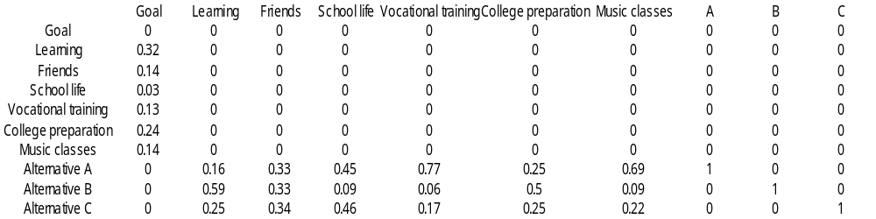
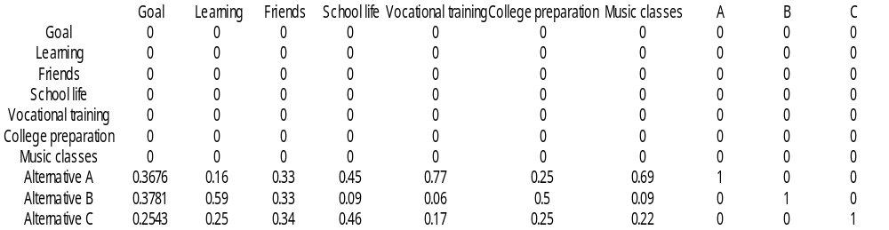
The School Hierarchy as Supermatrix
Limiting Supermatrix & Hierarchic Composition

Slide 20
Criteria Independent from Alternatives
When the criteria do not depend on the alternatives, the latter are kept out of the supermatrix and are evaluated in the usual hierarchic way by the distributive or ideal modes to make possible rank preservation or reversal as desired. The priorities of the criteria in terms of which the alternatives are evaluated hierarchically are taken from the limiting supermatrix. Here again benefit, cost, opportunity, and risk evaluation can be made to determine the ranks of the alternatives.

Slide 21
Structural Adjust
After & Before the Final Results
After computing the limiting results, if it is desired to group together elements from two or more clusters to determine their relative influence, the priorities of each cluster may be multiplied by the relative number of elements in that cluster to the total number in the set of clusters and then the entire set is normalized.
One may think to do such structural adjustment in the weighting process of the original supermatrix. There may be occasions where that is what should be done.

Slide 22
The Management of a Water Reservoir
Here we are faced with the decision to choose one of the possibilities of maintaining the water level in a dam at: Low (L), Medium (M) or High (H) depending on the relative importance of Flood Control (F), Recreation (R) and the generation of Hydroelectric Power (E) respectively for the three levels. The first set of three matrices gives the prioritization of the alternatives with respect to the criteria and the second set, those of the criteria in terms of the alternatives.

Slide 23
A Feedback System with Two Components
Flood Recreation Hydro-
Control Electric
Power
Low Intermediate High
Level Level Level

Slide 24
1) Which level is best for flood control?
Flood Control
Low Med High
Eigenvector
Low
Medium
High
1 5 7 .722
1/5 1 4 .205
1/7 1/4 1 .073
2) Which level is best for recreation?
Consistency Ratio = .107
Recreation
3) Which level is best for power generation?
Low Med High
Eigenvector
Low
Medium
High
1 1/7 1/5 .072
7 1 3 .649
5 1/3 1 .279
Power Generation
Low Med High
Eigenvector
Low
Medium
High
1 1/5 1/9 .058
5 1 1/5 .207
9 5 1 .735
Consistency Ratio = .056
Consistency Ratio = .101

Slide 25
Low Level Dam
F R E Eigenvector
Flood Control 1 3 5 .637
Recreation 1/3 1 3 .258
Hydro-Electric 1/5 1/3 1 .105
Power
1) At Low Level, which attribute is satisfied best?
Consistency Ratio = .033
Intermediate Level Dam
2) At Intermediate Level, which attribute is satisfied best?
F R E Eigenvector
Flood Control 1 1/3 1 .200
Recreation 3 1 3 .600
Hydro-Electric 1 1/3 1 .200
Power
Consistency Ratio = .000
High Level Dam
F R E Eigenvector
3) At High Level, which attribute is satisfied best?
Flood Control 1 1/5 1/9 .060
Recreation 5 1 1/4 .231
Hydro-Electric 9 4 1 .709
Power
Consistency Ratio = .061

Slide 26
The six eigenvectors were then introduced as columns of the following stochastic supermatrix.
F R E L M H
0 0 0 .637 .200 .060
0 0 0 .258 .600 .231
0 0 0 .105 .200 .709
.722 .072 .058 0 0 0
.205 .649 .207 0 0 0
.073 .279 .735 0 0 0
F
R
E
L
M
H
One must ensure that all columns sum to unity exactly.

Slide 27
The final priorities for both, the height of the dam and for the criteria were obtained from the limiting power of the supermatrix. The components were not weighted here because the matrix is already column stochastic and would give the same limiting result for the ratios even if multiplied by the weighting constants.
Its powers stabilize after a few iterations. We have
F R E L M H
0 0 0 .241 .241 .241
0 0 0 .374 .374 .374
0 0 0 .385 .385 .385
.223 .223 .223 0 0 0
.372 .372 .372 0 0 0
.405 .405 .405 0 0 0
F
R
E
L
M
H

Slide 28
The columns of each block of this matrix are identical, so that in the top right block we can read off the overall priority of each of the three criteria from any column, and read off the overall priorities of the three alternatives from any column of the bottom left block. It is clear from this analysis that for the kind of judgments provided, there is preference for a high dam with priority .405 for hydroelectric power generation with priority .385.

Slide 29
Choosing a Car: Foreign or Domestic?
Cost A E J Eigenvector
American C R D Eigenvector
A
E
J
1
1/5
1/3
5
1
3
3
1/3
1
.637
.105
.258
C
R
D
1
1/3
1/4
3
1
1
4
1
1
.634
.192
.174
Consistency Ratio = .033
Consistency Ratio = .008
Repair Cost A E J Eigenvector
European C R D Eigenvector
A
E
J
1
1/5
1/2
5
1
3
2
1/3
1
.582
.109
.309
C
R
D
1
1
2
1
1
2
1/2
1/2
1
.250
.250
.500
Consistency Ratio = .003
Consistency Ratio = .008
Durability A E J Eigenvector
Japanese C R D Eigenvector
A
E
J
1
5
3
1/5
1
1/3
1/3
3
1
.105
.637
.258
C
R
D
1
1/2
1
2
1
2
1
1/2
1
.400
.200
.400
Consistency Ratio = .033
Consistency Ratio = .000

Slide 30
Original Supermatrix
C R D A E J
0 0 0 .634 .250 .400
0 0 0 .192 .250 .200
0 0 0 .174 .500 .400
.637 .582 .105 0 0 0
.105 .109 .637 0 0 0
.258 .309 .258 0 0 0
C
R
D
A
E
J
Limiting Supermatrix
C R D A E J
0 0 0 .464 .464 .464
0 0 0 .210 .210 .210
0 0 0 .326 .326 .326
.452 .452 .452 0 0 0
.279 .279 .279 0 0 0
.269 .269 .269 0 0 0
C
R
D
A
E
J
Choose an American car. Cost is the dominant criterion.

Slide 31
Date and Strength of Recovery of U.S. Economy
Primary Factors
Conventional Economic
adjustment Restructuring
Consumption (C) Financial Sector (FS)
Exports (X) Defense Posture (DP)
Investment (I) Global Competition (GC)
Fiscal Policy (F)
Monetary Policy (M)
Confidence (K)
Subfactors
Adjustment Period
Required for
Turnaround
3 months 6 months 12 months 24 months
The U.S. Holarchy of Factors for Forecasting Turnaround in Economic Stagnation

Slide 32
Table 1: Matrices for subfactor importance relative to primary factors influencing the Timing of Recovery
Panel A: Which subfactor has the greater potential to influence Conventional Adjustment and how strongly?
Vector
C E I K F M Weights
Consumption (C)
Exports (E)
Investment (I)
Confidence (K)
Fiscal Policy (F)
Monetary Policy (M)
1 7 5 1/5 1/2 1/5 0.118
1/7 1 1/5 1/5 1/5 1/7 0.029
1/5 5 1 1/5 1/3 1/5 0.058
5 5 5 1 5 1 0.334
2 5 3 1/5 1 1/5 0.118
5 7 5 1 5 1 0.343
Panel B: Which subfactor has the greater potential to influence Economic Restructuring and how strongly?
Vector
FS DP GC Weights
Financial
Sector (FS)
Defense
Posture (DS)
Global
Competition (GC)
1 3 3 0.584
1/3 1 3 0.281
1/3 1/3 1 0.135

Slide 33
Table 2: Matrices for relative influence of subfactors on periods of adjustment (months) (Conventional Adjustment)
For each panel below, which time period is more likely to indicate a turnaround if the relevant factor is the sole driving force?
Panel A: Relative importance of targeted time periods for consumption to drive a turnaround
Panel B: Relative importance of targeted time periods for exports to drive a turnaround
3 6 12 24 Vec. Wts. 3 6 12 24 Vec. Wts.
3 months 1 1/5 1/7 1/7 .043
6 months 5 1 1/5 1/5 .113
12 months 7 5 1 1/3 .310
24 months 7 5 3 1 .534
3 months 1 1 1/5 1/5 .083
6 months 1 1 1/5 1/5 .083
12 months 5 5 1 1 .417
24 months 5 5 1 1 .417
Panel C: Relative importance of targeted time periods for investment to drive a turnaround
Panel D: Relative importance of targeted time periods for fiscal policy to drive a turnaround
3 6 12 24 Vec. Wts. 3 6 12 24 Vec. Wts.
3 months 1 1 1/5 1/5 .078
6 months 1 1 1/5 1/5 .078
12 months 5 5 1 1/3 .305
24 months 5 5 3 1 .538
3 months 1 1 1/3 1/5 .099
6 months 1 1 1/5 1/5 .087
12 months 3 5 1 1 .382
24 months 5 5 1 1 .432
Panel E: Relative importance of targeted time periods for monetary policy to drive a turnaround
Panel F: Expected time for a change of confidence indicators of consumer and investor activity to support a turnaround in the economy
3 6 12 24 Vec. Wts. 3 6 12 24 Vec. Wts.
3 months 1 5 7 7 .605
6 months 1/5 1 5 7 .262
12 months 1/7 1/5 1 1/5 .042
24 months 1/7 1/7 5 1 .091
3 months 1 3 5 5 .517
6 months 1/3 1 5 5 .305
12 months 1/5 1/5 1 5 .124
24 months 1/5 1/5 1/5 1 .054

Slide 34
Table 3: Matrices for relative influence of subfactors on periods of adjustment (months) (Economic Restructuring)
For each panel below, which time period is more likely to indicate a turnaround if the relevant factor is the sole driving force?
Panel A: Financial system restructuring time
Panel B: Defense readjustment time
3 6 12 24 Vec. Wts. 3 6 12 24 Vec. Wts.
3 months 1 1/3 1/5 1/7 .049
6 months 3 1 1/5 1/7 .085
12 months 5 5 1 1/5 .236
24 months 7 7 5 1 .630
3 months 1 1/3 1/5 1/7 .049
6 months 3 1 1/5 1/7 .085
12 months 5 5 1 1/5 .236
24 months 7 7 5 1 .630
Panel C: Global competition adjustment time
3 6 12 24 Vec. Wts.
3 months 1 1 1/5 1/5 .078
6 months 1 1 1/5 1/5 .078
12 months 5 5 1 1/3 .305
24 months 5 5 3 1 .538
Table 4: Most likely factor to dominate during a specified time period
Which factor is more likely to produce a turnaround during the specified time period? Conventional Adjustment CA
Restructuring R
Panel A: 3 Months Panel B: 6 Months Panel C: 1 Year Panel D: 2 Years
CA R Vec. Wts. CA R Vec. Wts. CA R Vec. Wts. CA R Vec. Wts.
CA 1 5 .833 CA 1 5 .833 CA 1 1 CA 1 1/5 .167
R 1/5 1 .167 R 1/5 1 .167 R 1 1 R 5 1 .833
.500
.500

Slide 35
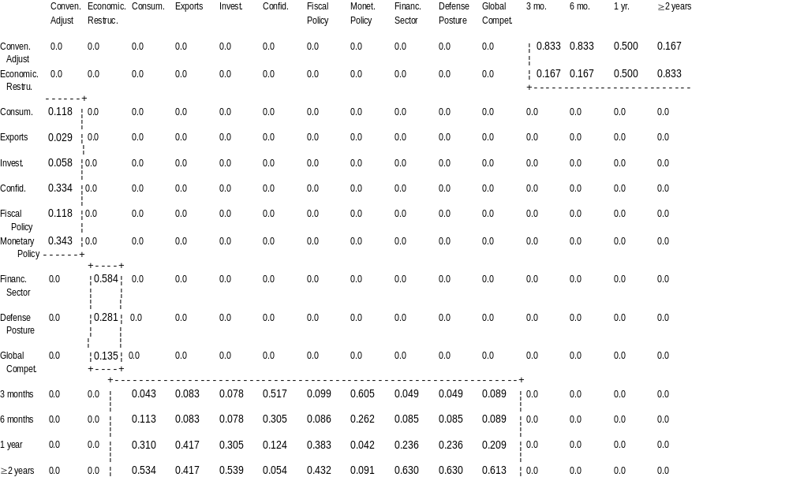
Table 5: The Completed Supermatrix

Slide 36
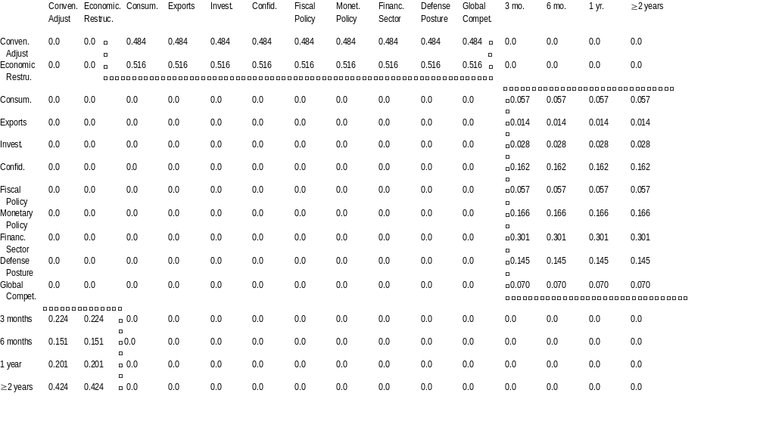
Table 6: The Limiting Supermatrix

Slide 37
Synthesis/Results
When the judgments were made, the AHP framework was used to perform a synthesis which produced the following results. First a meaningful turnaround in the economy would likely require an additional ten to eleven months, occurring during the fourth quarter of 1992. This forecast is derived from weights generated in the first column of the limiting matrix in Table 6, coupled with the mid-points of the alternate time periods (so as to provide unbiased estimates:
.224 x 1.5 + .151 x 4.5 + .201 x 9 + .424 x 18 =
10.45 months from late December 1991/early January 1992

Slide 38
The Strength of Recovery
Primary Factors Conventional Economic
Adjustment Restructuring
Subfactors Consumption (C) Financial Sector (FS)
Exports (X) Defense Posture (DP)
Investment (I) Global Competition (GC)
Fiscal Policy (F)
Monetary Policy (M)
Confidence (K)
Very Strong Strong Moderate Weak
(5.5-6.5% GNP) (4.5-5.5% GNP) (3-4.5% GNP) (2-3% GNP)

Slide 39
Table 7: Matrices for Primary and Subfactors for Strength of Recovery
Panel A: Which primary factor will be more influential in determining the Strength of Recovery?
Vector
CA R Weights
Conventional
Adjustment (CA) 1 1/5 .167
Restructuring (R) 5 1 .833
Panel B: Which subfactor is more important in influencing Conventional Adjustment?
Vector
C E I K F M Weights
Consumption (C)
Exports (E)
Investment (I)
Confidence (K)
Fiscal Policy (F)
Monetary Policy (M)
1 7 3 1 7 3 0.317
1/7 1 1/5 1/5 1 1/5 0.037
1/3 5 1 1/3 1/3 1/5 0.099
1 5 3 1 7 3 0.305
1/7 1 3 1/7 1 1/7 0.035
1/3 7 5 1/3 7 1 0.207
Panel C: Which subfactor is more important in influencing Economic Restructuring?
Vector
FS DP GC Weights
Financial
Sector (FS)
Defense
Posture (DS)
Global
Competition (GC)
1 1/5 1/3 0.105
5 1 3 0.637
3 1/3 1 0.258
CI = 0.037

Slide 40
Table 8: Matrices for relative influence of subfactors on Strength of Recovery (Conventional Adjustment)
For each panel below, which intensity is more likely to obtain if the designated factor drives the recovery?
Panel A: Relative likelihood of the strength of recovery if consumption drives the expansion
Panel B: Relative likelihood of the strength of recovery if exports drives the expansion
V S M W Vec. Wts. V S M W Vec. Wts.
Very Strong (V)
Strong (S)
Moderate (M)
Weak (W)
1
1
1/5
1/7
1
1
1/5
1/7
5
5
1
1/3
7
7
3
1
.423
.423
.104
.051
Very Strong (V)
Strong (S)
Moderate (M)
Weak (W)
1
1
3
5
1
1
3
5
1/3
1/3
1
3
1/5
1/5
1/3
1
.095
.095
.249
.560
CI = 0.028
CI = 0.016
Panel C: Relative likelihood of the strength of recovery if investment drives the expansion
Panel D: Relative likelihood of the strength of recovery if confidence drives the expansion
V S M W Vec. Wts. V S M W Vec. Wts.
Very Strong (V)
Strong (S)
Moderate (M)
Weak (W)
1
1
3
1/2
1
1
3
1/2
1/3
1/3
1
1/6
2
2
6
1
.182
.182
.545
.091
Very Strong (V)
Strong (S)
Moderate (M)
Weak (W)
1
1
1/3
1/5
1
1
1/3
1/5
3
3
1/3
1/7
5
5
7
1
.376
.376
.193
.054
CI = 0.0
CI = 0.101
Panel E: Relative likelihood of the strength of recovery if fiscal policy drive the expansion
Panel F: Relative likelihood of the strength of recovery if monetary policy drives the expansion
V S M W Vec. Wts. V S M W Vec. Wts.
Very Strong (V)
Strong (S)
Moderate (M)
Weak (W)
1
1
5
1
1
1
5
1
1/5
1/5
1
1/5
1
1
5
1
.125
.125
.625
.125
Very Strong (V)
Strong (S)
Moderate (M)
Weak (W)
1
1
5
3
1
1
5
3
1/5
1/5
1
1/7
1/3
1/3
7
1
.084
.084
.649
.183
CI = 0.0
CI = 0.101

Slide 41
Table 9: Matrices for relative influence of subfactors on Strength of Recovery (Restructuring)
For each panel below, which intensity is more likely to obtain if the designated factor drives the recovery?
Panel A: Relative likelihood of the strength of recovery if financial sector drives the expansion
Panel B: Relative likelihood of the strength of recovery if defense posture drives the expansion
V S M W Vec. Wts. V S M W Vec. Wts.
Very Strong (V)
Strong (S)
Moderate (M)
Weak (W)
1
1
3
5
1
1
3
5
1/3
1/3
1
1/3
1/5
1/5
1/3
1
.095
.095
.249
.560
Very Strong (V)
Strong (S)
Moderate (M)
Weak (W)
1
3
5
7
1/3
1
3
5
1/5
1/3
1
3
1/7
1/5
1/3
1
.055
.118
.262
.565
CI = 0.016
CI = 0.044
Panel C: Relative likelihood of the strength of recovery if global competition drives the expansion
V S M W Vec. Wts.
Very Strong (V)
Strong (S)
Moderate (M)
Weak (W)
1
1
3
5
1
1
3
5
1/3
1/3
1
1
1/5
1/5
1
1
.101
.101
.348
.449
CI = 0.012
Table 10: Overall Results for Strength of Recovery
% GNP Growth
Very Strong (5.5-6.5) Strong (4.5-.5) Moderate (3-4.5)
Weak (2-3)
0.108
0.141
0.290
0.461
% GNP Recovery Rate* 3.6
*% GNP Recovery rate calculated using the relative strength of conventional adjustment and restructuring in Table 5 Panel A
each used to multiply midpoints of % GNP Growth and then summed.

Slide 42
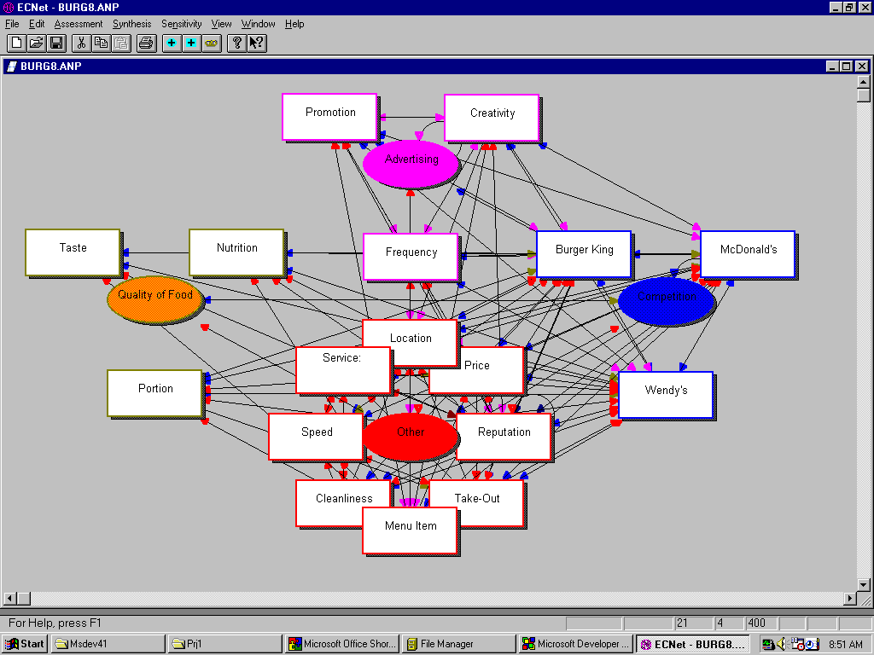
Hamburger Model
Estimating Market Share of Wendy’s, Burger King and McDonald’s
with respect to the single economic control criterion

Slide 43
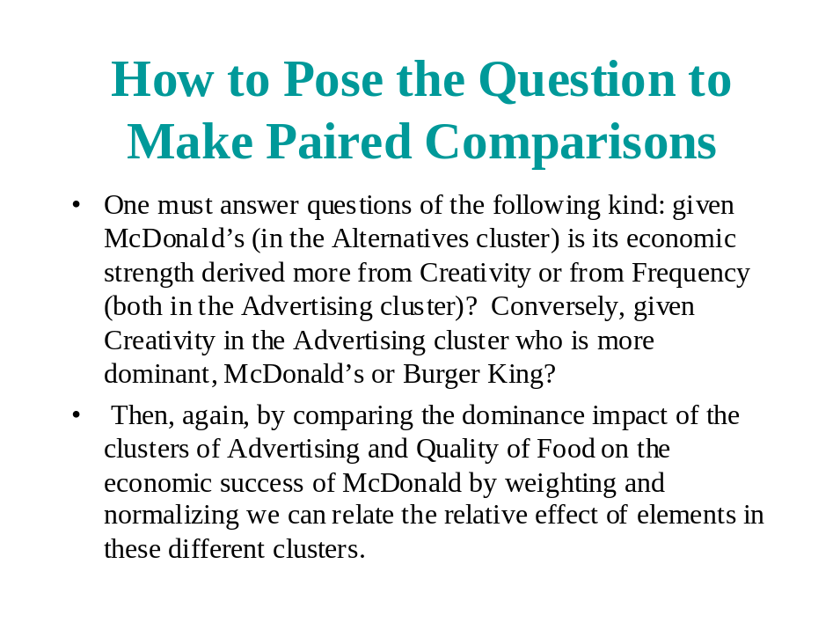

Slide 44
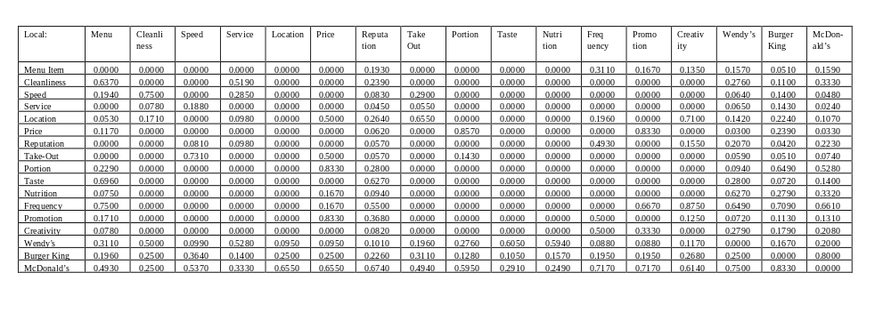
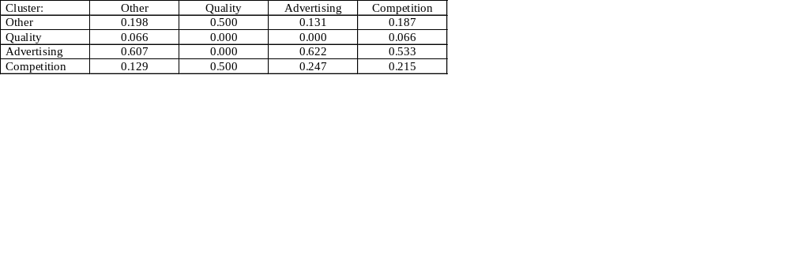
Hamburger Model Supermatrix
Other
Quality
Advertising
Competition
O
t
h
e
r
Q
Ad
C
o
m
p
Cluster Priorities Matrix

Slide 45
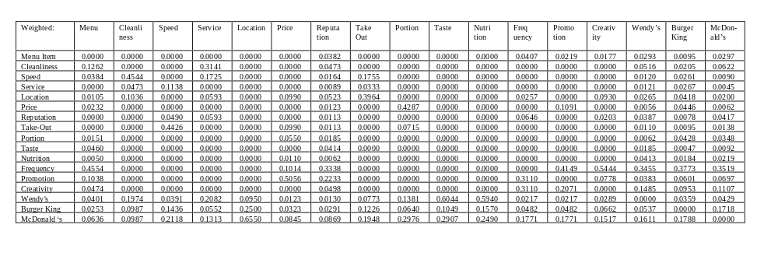
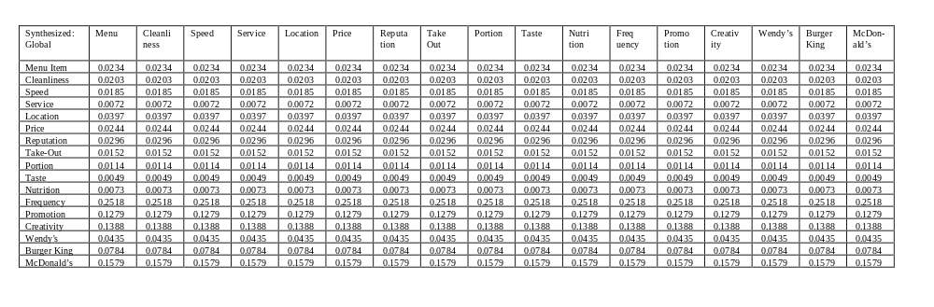
Weighted Supermatrix
Limiting Supermatrix
{
Relative local weights: Wendy’s= 0.156, Burger King =0.281, and McDonald’s=0.566

Slide 46
Validation
The same problem worked as a simple and
a complex hierarchy and as a feedback network.

Slide 47

Hamburger Model
Synthesized Local:
Other Menu Item 0.132
Cleanliness 0.115
Speed 0.104
Service 0.040
Location 0.224
Price 0.138
Reputation 0.167
Take-Out 0.086
Quality Portion 0.494
Taste 0.214
Nutrition 0.316
Synthesized Local Cont’d:
Advertising Frequency 0.485
Promotion 0.246
Creativity 0.267
Competition Wendy’s 0.156
Burger King 0.281
McDonald’s 0.566
Simple Hierarchy Complex Hierarchy Feedback Actual
(Three Level) (Several Levels) Network Market
Share
Wendy’s 0.3055 0.1884 0.156 0.1320
Burger King 0.2305 0.2689 0.281 0.2857
McDonald’s 0.4640 0.5427 0.566 0.5823

Slide 48
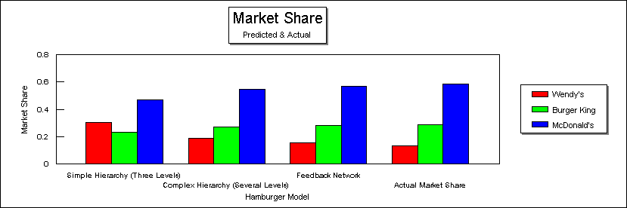
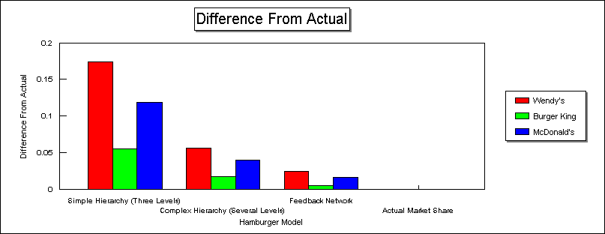

Slide 49
Strategic Planning
for the Future of the
University of Pittsburgh Medical Center
Using the Analytic Network Process(ANP)

Slide 50
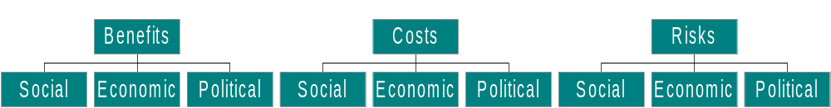
Evaluate Strategies for the University Health Network to Compete in a Managed Care Environment
Benefits Control Model
Costs Control Model
Risks Control Model
Social Benefits Network Submodel
Economic Benefits Network Submodel
Political Benefits Network Submodel
Social Costs Network Submodel
Economic Costs
Network Submodel
Political Costs Network Submodel
Social Risks Network Submodel
Economic Risks Network Submodel
Political Risks Network Submodel

Slide 51
List of Clusters and Elements (Not all the Clusters appear in all 9 of the sub-models.)
Cluster Names Cluster Elements
Clients Businesses- businesses that offer employees health care plans
Consumers- individuals who purchase their own health coverage
Insurers- companies who sell health insurance
Competition Competitors- other hospitals in Pittsburgh that compete w/ UPMC
Convenience Time- expended by customer scheduling, traveling, and actual waiting room
Safety- safety of location
Internal Stakeholders Physicians- working for UPMC
Administrators- planners, managers, decision makers of UPMC
Alliances- outside organizations, involved: isurers, hospitals, physician networks
Staff- non-physician, non-administrative personel
Public Relations Public Relations- UPMC’s public image: TV, Newspaper, Radio
Quality Specialty quality non-general health services,
Diversity- range of health services offered by UPMC
Care- quality of general health services
Research- quality of research at UPMC
*Strategies Improve and Measure Outcomes- measure effectiveness to improve service
Capitalization- negotiated insurance contracts with fixed payments
Develop a Primary Network- increase number of primary care physicians
Internal Cost Reduction- cut facilities, employees, and high cost procedures
Teach Primary Care- shift focus from curative care to preventive care
Variety of Services Internal Medicine and Surgery- Curative specialty services and hospitalization
Cancer Treatment- cancer treatment cure
Outpatient Care- preventive care and short term medical treatments
*Strategies apperar in every sub-moadel as alternatives of choice

Slide 52
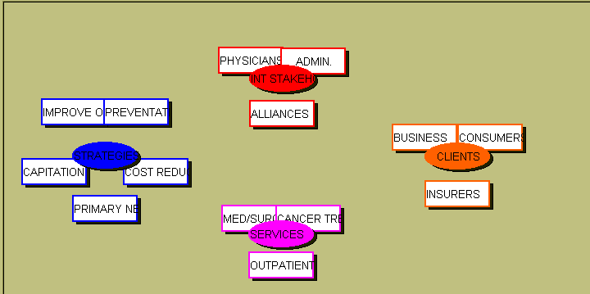
Clusters and Elements in the Economic Benefits Sub-model

Slide 53

Benefits & Costs
Predicting the Superbowl Winner ‘96 & ‘97

Slide 54
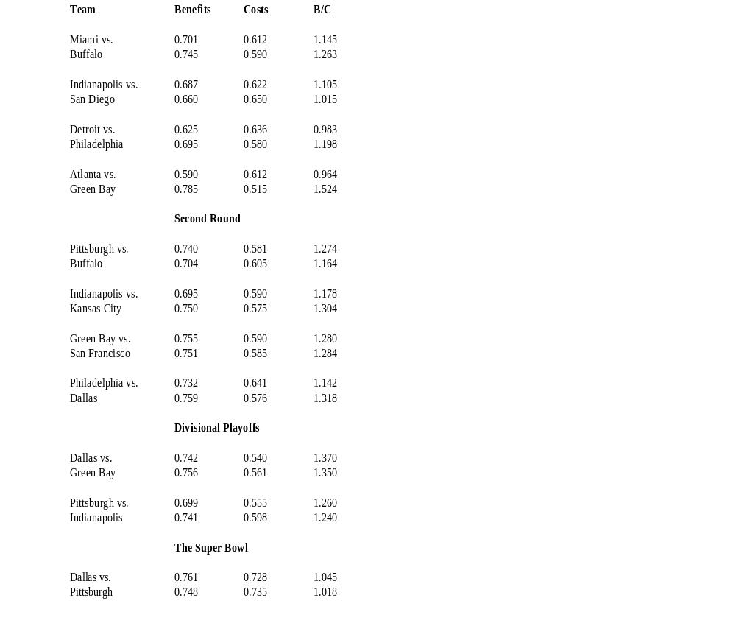
Pre-start (early December 1995)
Wild Card Games
All predictions correct except for two games below.
1996 Playoffs
Kansas kicker missed 3 field goals & ruined them.
No way to know his ailments that day.
Was too close to determine the winner.
Green Bay won.

Slide 55
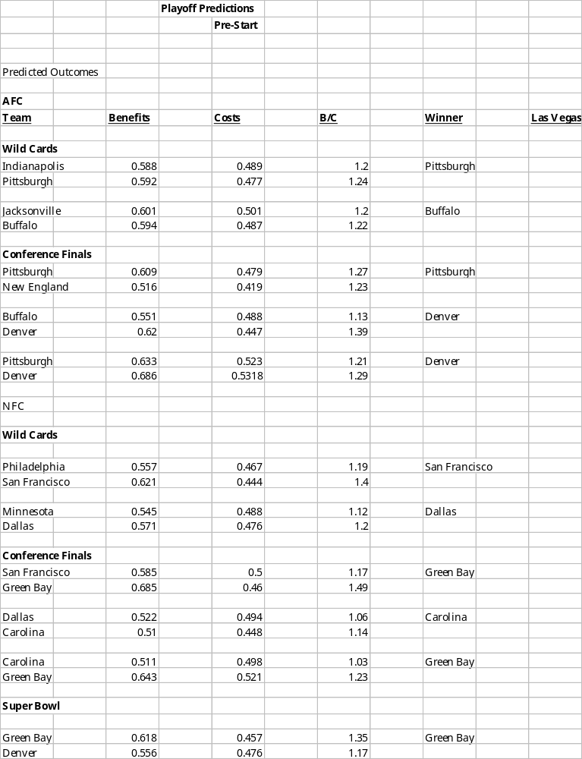
Pre-start (early December 1996)
The first predictions were wrong
on three games which then
required revision.
Wrong prediction.
Wrong prediction.
1997 Playoffs
Wrong prediction.

Slide 56
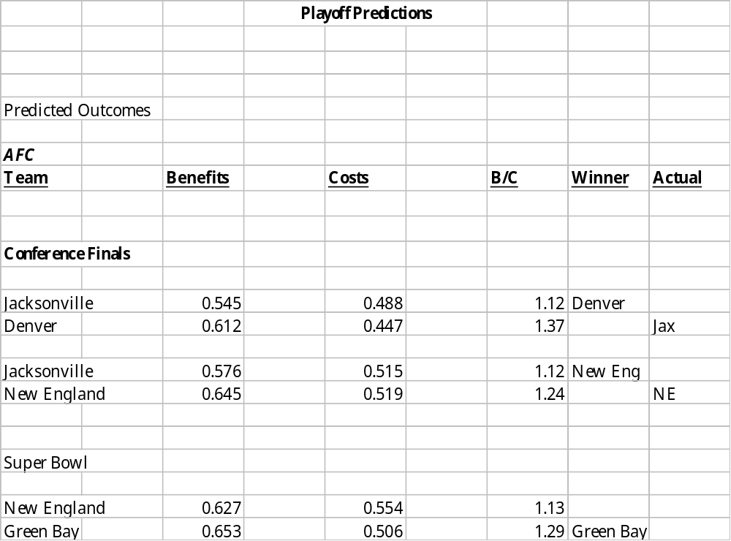
Post-start (before Conference Finals)
A gains error in one game.

Slide 57
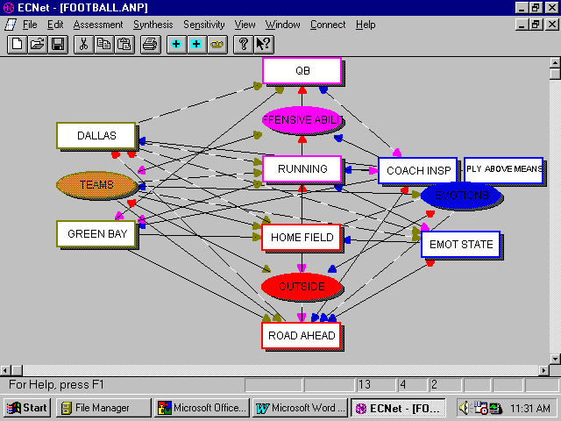
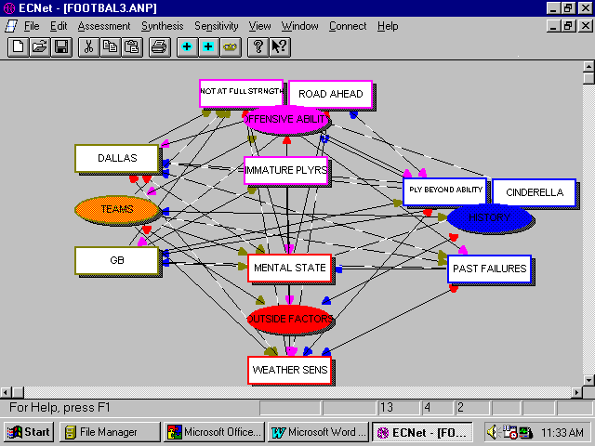
The Benefits
The Costs

Slide 58
Benefits Supermatrix
Local Weights Offensive Emotions Outside Teams
Global Local QB Ability Running Play Above Coaching Emotions Home Field Road Ahead Dallas Green Bay
Offense
Emotions
Outside
Teams
QB Ability
Running
Play Above
Ability
Coaching
Emotional State
Home Field
Road Ahead
Dallas
Green Bay
0.0297
0.3140
0.0037
0.0235
0.0923
0.0433
0.3670
0.1227
0.0039
0.0864
0.9136
0.0309
0.1962
0.7724
0.1055
0.8945
0.9693
0.0308
1.0000
1.0000
1.0000
1.0000
0.8000
0.2000
1.0000
0.7500
0.2500
1.0000
.8000
.2000
1.0000
1.0000
1.0000
0.7500
0.2500
1.0000
1.0000
1.0000
0.8000
0.2000
0.2000
0.8000
CLUSTER WEIGHTS
Offense Emotions Outside Teams
0.0000 0.2449 0.6442 0.7172
0.2176 0.0000 0.0852 0.1947
0.0914 0.0902 0.0000 0.0881
0.6910 0.6648 0.2706 0.0000
Offense
Emotions
Outside
Team

Slide 59
Weighted Supermatrix
Cluster Weights Offensive Emotions Outside Teams
Global Local QB Ability Running Play Above Coaching Emotions Home Field Road Ahead Dallas Green Bay
Offense
Emotions
Outside
Teams
QB Ability
Running
Play Above
Ability
Coaching
Emotional State
Home Field
Road Ahead
Dallas
Green Bay
0.0297
0.3140
0.0037
0.0235
0.0923
0.0433
0.3670
0.1227
0.0039
0.0864
0.9136
0.0309
0.1962
0.7724
0.1055
0.8945
0.9693
0.0308
1.0000
1.0000
0.7308
0.2692
0.1959
0.0490
0.0902
0.4986
0.1662
0.7308
0.0538
0.2153
0.5154
0.1288
0.0852
0.2706
0.6442
0.0639
0.0213
0.2706
0.6885
0.3115
0.7125
0.1781
0.0219
0.0875
Limiting Benefits Supermatrix
Offensive Emotions Outside Teams
Global Local QB Ability Running Play Above Coaching Emotions Home Field Road Ahead Dallas Green Bay
Offense
Emotions
Outside
Teams
QB Ability
Running
Play Above
Ability
Coaching
Emotional State
Home Field
Road Ahead
Dallas
Green Bay
0.0297
0.3140
0.0037
0.0235
0.0923
0.0433
0.3670
0.1227
0.0039
0.0297
0.3140
0.0037
0.0235
0.0923
0.0433
0.3670
0.1227
0.0039
0.0297
0.3140
0.0037
0.0235
0.0923
0.0433
0.3670
0.1227
0.0039
0.0297
0.3140
0.0037
0.0235
0.0923
0.0433
0.3670
0.1227
0.0039
0.0297
0.3140
0.0037
0.0235
0.0923
0.0433
0.3670
0.1227
0.0039
0.0297
0.3140
0.0037
0.0235
0.0923
0.0433
0.3670
0.1227
0.0039
0.0297
0.3140
0.0037
0.0235
0.0923
0.0433
0.3670
0.1227
0.0039
0.0297
0.3140
0.0037
0.0235
0.0923
0.0433
0.3670
0.1227
0.0039
0.0297
0.3140
0.0037
0.0235
0.0923
0.0433
0.3670
0.1227
0.0039
0.0297
0.3140
0.0037
0.0235
0.0923
0.0433
0.3670
0.1227
0.0039
0.0297
0.3140
0.0037
0.0235
0.0923
0.0433
0.3670
0.1227
0.0039

Slide 60
Costs Supermatrix
Local Weights Offensive Emotions Outside Teams
Play
beyond
Immature Not Full
Past Mental
Global Local Road Ahead Players Strength Cinderella Ability Failures State Weather Dallas Green Bay
Offense
History
Outside
Teams
Road Ahead
Immature Players
Not Full Strength
Cinderella
Play Bey Ability
Past Failures
Mental State
Weather
Dallas
Green Bay
0.1529
0.0000
0.2261
0.0011
0.2002
0.0738
0.0121
0.1683
0.1653
0.0000
0.4034
0.0000
0.5966
0.0041
0.7278
0.2683
0.0673
0.9332
1.0002
0.0000
1.0000
0.8571
0.1429
0.8333
0.1667
1.0000
0.8000
0.2000
1.0000
1.0000
1.0000
0.8000
0.2000
1.0000
1.0000
1.0000
0.7500
0.2500
1.0000
0.7500
0.2500
1.0000
0.8333
0.1667
0.2000
0.8000
0.7500
0.2500
1.000
CLUSTER WEIGHTS
Offense Emotions Outside Teams
0.0000 0.3614 0.6267 0.7172
0.0877 0.0000 0.0936 0.1947
0.1392 0.0650 0.0000 0.0881
0.7731 0.5736 0.2797 0.0000
Offense
Emotions
Outside
Team

Slide 61
Weighted Supermatrix
Cluster Weighted Offensive Emotions Outside Teams
Play
beyond
Immature Not Full
Past Mental
Global Local Road Ahead Players Strength Cinderella Ability Failures State Weather Dallas Green Bay
Offense
History
Outside
Teams
Road Ahead
Immature Players
Not Full Strength
Cinderella
Play Bey Ability
Past Failures
Mental State
Weather
Dallas
Green Bay
0.1529
0.0000
0.2261
0.0011
0.2002
0.0738
0.0121
0.1683
0.1653
0.0000
0.4034
0.0000
0.5966
0.0041
0.7278
0.2683
0.0673
0.9332
1.0002
0.0000
1.0000
0.8571
0.1429
0.8333
0.1667
1.0000
0.2891
0.0723
1.0000
0.5014
0.1253
0.0936
0.2797
0.6267
0.0702
0.0234
0.2797
0.5379
0.1793
0.1947
0.0734
0.0147
0.1434
0.5738
0.1460
0.0487
0.0881
Limiting Costs Supermatrix
Offensive Emotions Outside Teams
Play
beyond
Immature Not Full
Past Mental
Global Local Road Ahead Players Strength Cinderella Ability Failures State Weather Dallas Green Bay
Offense
History
Outside
Teams
Road Ahead
Immature Players
Not Full Strength
Cinderella
Play Bey Ability
Past Failures
Mental State
Weather
Dallas
Green Bay
0.1529
0.0000
0.2261
0.0011
0.2002
0.0738
0.0212
0.1683
0.1653
0.0000
0.1529
0.0000
0.2261
0.0011
0.2002
0.0738
0.0212
0.1683
0.1653
0.0000
0.1529
0.0000
0.2261
0.0011
0.2002
0.0738
0.0212
0.1683
0.1653
0.0000
0.1529
0.0000
0.2261
0.0011
0.2002
0.0738
0.0212
0.1683
0.1653
0.0000
0.1529
0.0000
0.2261
0.0011
0.2002
0.0738
0.0212
0.1683
0.1653
0.0000
0.1529
0.0000
0.2261
0.0011
0.2002
0.0738
0.0212
0.1683
0.1653
0.0000
0.1529
0.0000
0.2261
0.0011
0.2002
0.0738
0.0212
0.1683
0.1653
0.0000
0.1529
0.0000
0.2261
0.0011
0.2002
0.0738
0.0212
0.1683
0.1653
0.0000
0.1529
0.0000
0.2261
0.0011
0.2002
0.0738
0.0212
0.1683
0.1653
0.0000
0.1529
0.0000
0.2261
0.0011
0.2002
0.0738
0.0212
0.1683
0.1653
0.0000
0.1529
0.0000
0.2261
0.0011
0.2002
0.0738
0.0212
0.1683
0.1653
0.0000
0.1529
0.0000
0.2261
0.0011
0.2002
0.0738
0.0212
0.1683
0.1653
0.0000

Slide 62
Benefits Intensity Priorities
Costs Intensity Priorities
Quarterback (0.030):
Average (0.091) Good (0.281) High Ability (0.691)^{GB,D}
Running Game (0.314):
Average (0.084) Good (0.211)^{GB} High Ability (0.705)^{D}
Play Above Potential (0.004):
Average (0.075) Good (0.229)^{D} High Play Level (0.696)^{GB}
Coaching Ability
to Inspire (0.023):
Not A lot (0.078) Somewhat (0.205)^{D} Heroic (0.717)^{GB}
Emotional State (0.092):
Apathy (0.082) Mediocre (0.236) Excitement (0.682)^{GB,D}
Home Field
Advantage (0.043): Significant
Neutral (0.105) Some Effect (0.258)^{GB} Effect (0.637)^{D}
Very
The Road Ahead (0.367): Some Effect (0.236)^{D} Confident (0.682)^{GB}
No Effect (0.082)
Dallas’ Effect on the Ultimate Greatly
Outcome (0.123): Medium (0.280) Influenced (0.627)^{GB,D}
Low Effect (0.094)
Green Bay’s Effect on the Ultimate Greatly
Outcome (0.004): Medium (0.258) Influenced (0.637)^{GB,D}
Not Much (0.105)
The Road Ahead (0.153):
Low Effect (0.085) Somewhat (0.271)^{GB,D} High Effect (0.644)
Not at Full Strength
(0.226): Some Big Injury
Few Injuries (0.091) Injuries (0.218) Problems (0.644) ^{GB,D}
Playing Beyond Ability (0.200):
Not a factor (0.094) ^{GB,D} May Falter (0.288) Venerable (0.627)
Past Failures (0.074): Can’t get
Good History (0.082) ^{GB} Mixed Past (0.236)^{D} it Gone (0.682)
Mental State
of Preparedness (0.012): May be
Ready (0.122)^{GB} Hurt (0.230)^{D} Unready (0.648)
Cinderalla Team (0.001): Good Team
Not Cinderalla (0.082) ^{GB,D} Lucky (0.236) It’s Midnight (0.682)
Weather Sensitivity (0.168): Small High
Anything Goes (0.095)^{D} Sensitivity (0.250)^{GB} Sensitivity (0.655)
Dallas’ Effect (0.165):
Small (0.163) Medium (0.297) High (0.540)^{GB,D}
Green Bay’s Effect (0.000)
Small (0.105)^{D} Medium (0.258) Big Effect (0.637)^{GB}
Immature Players (0.000) Some Young
Veterans (0.082)^{D} Experience (0.236)^{GB} Players (0.682)
Each of the two teams obtained a total score from the intensities.

Slide 63
Illustrative Considerations in the Evaluation
of 1996 Dallas - Green Bay Game
For the Benefits Model:
- With respect to Green Bay, Quarterback is equally to moderately more important than Dallas. Here we are comparing an aspect of the Green Bay team to their opponent, Dallas effectively, we are asking ourselves, which is more important to Green Bay’s success, the fact that they have Brett Favre, or the fact that they are playing Dallas. The judgment was made that while Favre is an outstanding quarterback, the fact that he is facing Dallas may be enough to counteract his abilities.
- With respect to Dallas, the Road Ahead is strongly more important than Home Field Advantage. The Road Ahead refers to future games that the team may have to play if the team continues on. Here, the relative ease of the road ahead for Dallas, based on the record of the AFC in the Super Bowl, causes it to be less important than the fact that Dallas is playing Green Bay, possibly its biggest obstacle to winning the Super Bowl, on its home turf.
- With respect to Dallas, Running Game is equally to moderately stronger than Quarterback. This judgment is based on the fact that while Dallas’ quarterback is excellent the team’s Running Game is quite often the league’s best.
- With respect to Dallas, Quarterback is strongly to very strongly more important than Coaching Inspiration. The basis for this is the fact that Barry Switzer has exhibited no great gift for inspiration, the team simply is full of talent, especially in the quarterback position.

Slide 64
For the Costs Model:
- With respect to Green Bay, Mental State is strongly more important than Weather Sensitivity, simply because Green Bay’s Mental State could be more easily called into question (may not be tough enough) than their Weather Sensitivity (they are very insensitive to poor weather conditions.
- With respect to Dallas, Mental State is moderately more important than Weather Sensitivity. While the team is not highly Weather Sensitive, their arrogant attitudes causes us a bit of concern that it may be their undoing.
- With respect to Green Bay, Not at Full Strength is moderately more important than The Road Ahead. The basis for this being that Reggie White, a very important player on the team, is not 100%, and this is likely to have a larger impact than any AFC team that Green Bay might meet in the Super Bowl because, as we stated before, AFC teams do not traditionally pose a threat. Conversely, if we looked at an AFC matchup, the Road Ahead would in most cases have a large impact due to the fact that the AFC teams are usually unsuccessful against the NFC teams in the Super Bowl.
- With respect o Green Bay, Dallas is strongly more important than Cinderella. This translates to mean that any Cinderella story that Green Bay may be enjoying is likely to be overshadowed by the fact that they are playing Dallas. While Green Bay is not widely considered to be a Cinderella, the label would have a larger effect on a team like the Indianapolis Colts when they played Kansas City.
- With respect to Dallas, Not at Full Strength is strongly more important than Immature Players. While Dallas has many veterans, its biggest problem in this comparison could be injuries to key players such as Charles Haley.
- With respect to Dallas, Past Failures are equally important as Play Beyond Ability. Not only is Dallas playing up to its potential, it has a few grave failures of the past to look back on.
- Now that we have looked at several examples of judgments, we can move on to the results of the model. The elements in the model are given weights based on our judgment. We can rate the teams using information that we have collected. For instance, if Green Bay’s passing statistics are traditionally low against Dallas, Green Bay’s likelihood of success against Dallas is comprised by the fact that the team relies heavily on that kind of play. We determined that passing is important to Green Bay in our judgments, and find that their passing suffers against Dallas in the statistical data that we collected.
Conclusion
It is our hope to use this model to forecast future Super Bowl competitions. Undoubtedly, there will be additional modifications. This basic ideas learned here can be used to forecast the outcome of other competitive games. It appears that the use of intangibles is significantly more important in the forecast than the strict accuracy of the statistics, although one cannot do without the statistics which tell more about performance than about attitude and environment.

Slide 65
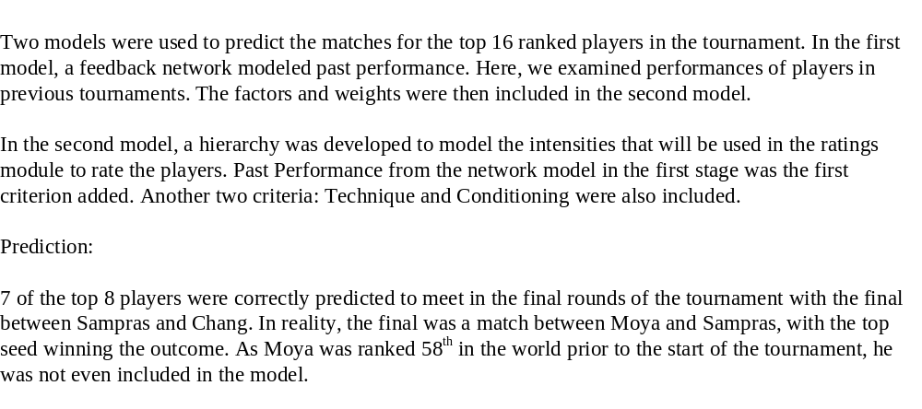
Prediction of the 1997 Australian Tennis Open

Slide 66
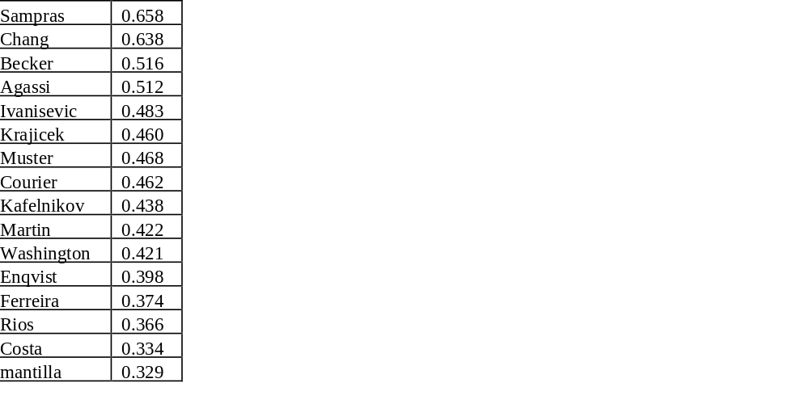

Slide 67
Hong Kong Competes with Singapore
and somewhat less with Tokyo
as Financial Center in Asia
in the 21st Century
Gang Hu (Tianjin), Chia-Shuan Huang (Taiwan), Hong Li (Beijing), Thomas Saaty (Pittsburgh),
Torsten Schmidt (Germany), and Yu-Chan Wang (Taiwan).

Slide 68
The Purpose
The purpose of this project is to study the potential impact imposed through the takeover of Hong Kong by China in 1997. The analysis focuses on the following questions:
What set of criteria does an Asian location have to meet in order to be a Financial Center?
Which city is the best candidate for the Financial Center in the Asia-Pacific region in 1996?
What is the most likely policy of the Chinese government towards Hong Kong after 1997?
What impact does the Chinese policy have towards Hong Kong as a Financial Center?
Which city is the most likely candidate to be the Financial Center is the Asia-Pacific region in the year 2000?

Slide 69
The Approach
These five questions are studied with the methodology and technique provided by a combination of the AHP and ANP. A dual-model approach was developed. The first model, the “Financial Center model” which is an ANP model, was used to examine the first two of the above questions. The second model, the “Mainland China Policy model” is an AHP model, used to focus on the third question above to generate a policy package most likely to be adopted by the Chinese government. Based on changed in the political, economic, and social environments incurred by the estimated policy package, the “Financial Center model” was re-evaluated. The fourth and fifth questions above are thus answered.
The two models complement one another because:
1. The Financial Center model provides the relevant factors for a focused examination under the China model in order to find the relevant factors which may be changed by the Chinese government, and
2. The China model provides a package of feasible (for mainland China) and likely policies to be adopted by the Chinese government after 1997. Based on the package of policies, a second evaluation of the Financial Center model was made in order to estimate the future status of Hong Kong as a Financial Center.

Slide 70
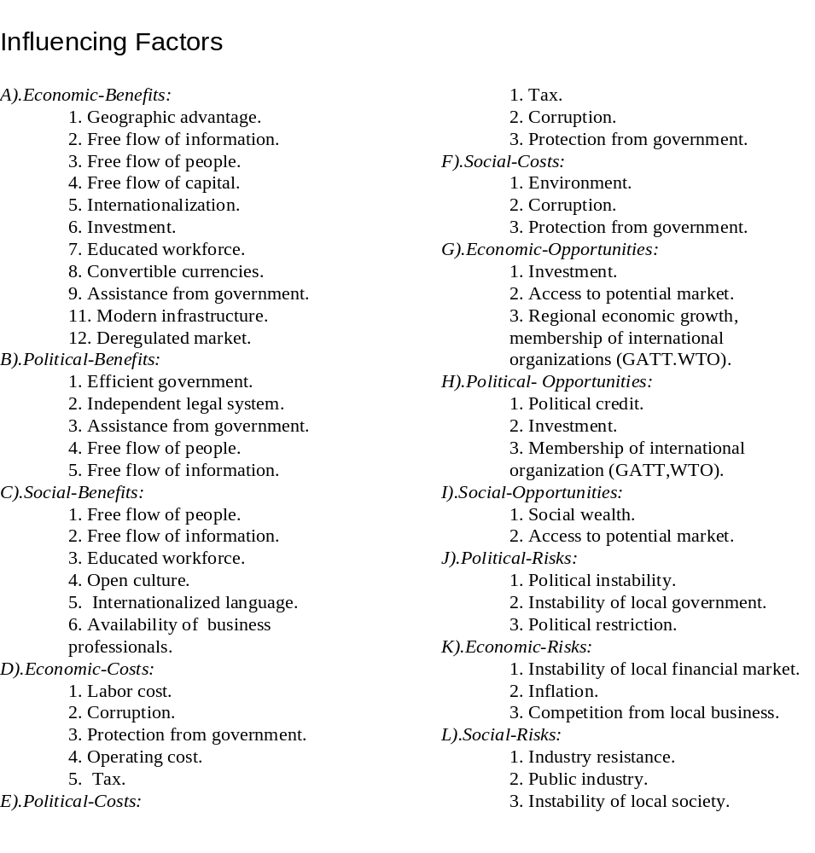

Slide 71
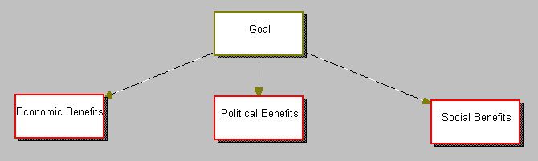
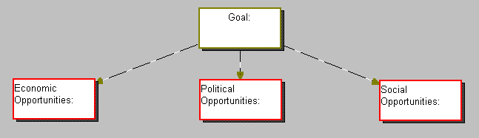
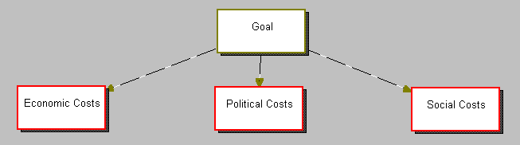
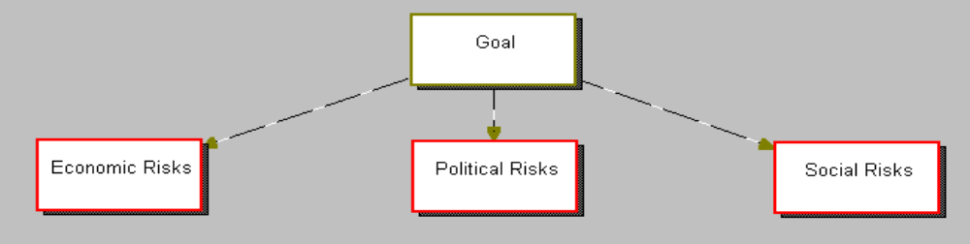
The Set of Four Control Hierarchies
Benefits Control Model
Opportunities Control Model
*
Costs Control Model
Risks Control Model
*

Slide 72

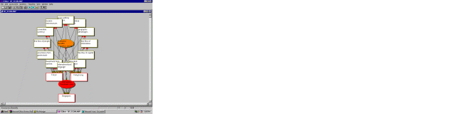
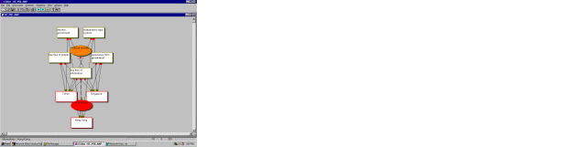
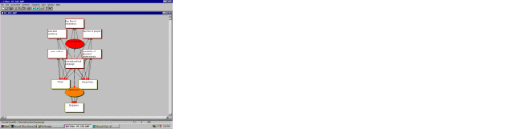
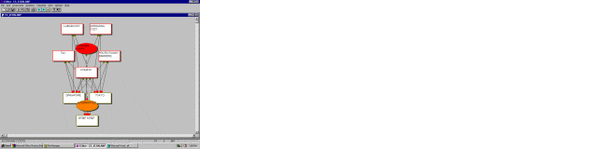
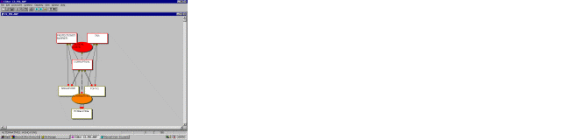
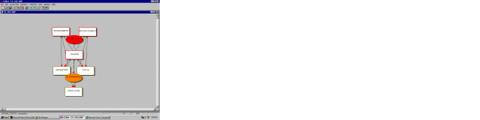
Benefits
Costs

Slide 73
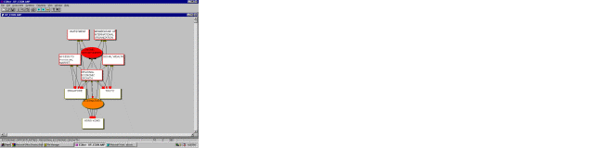
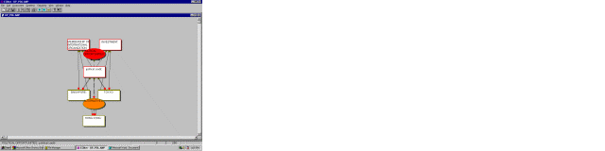

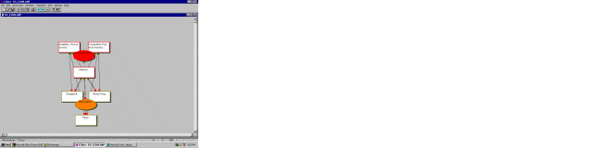
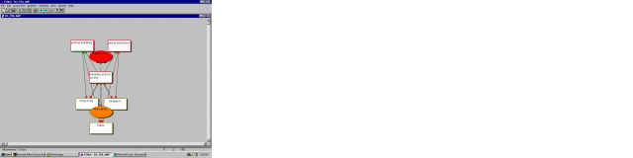
Opportunities
Risks

Slide 74
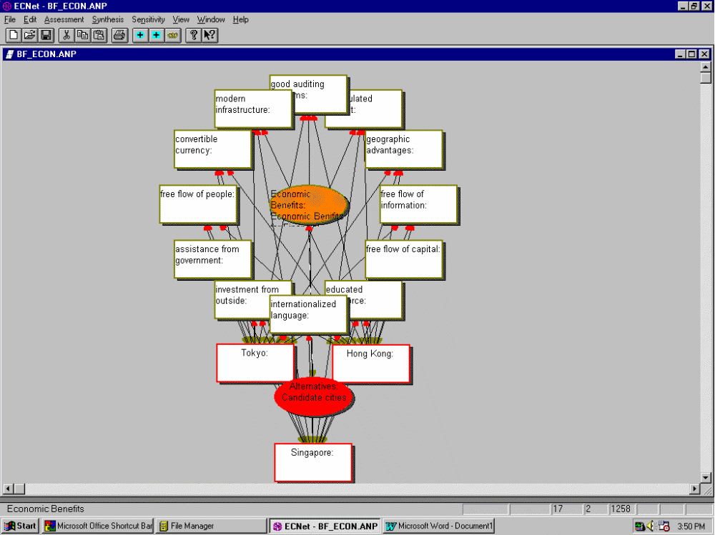
Economic Benefits Sub-Model

Slide 75
Results
There are twelve supermatrices associated with the complete model. With each of these supermatrices is associated a cluster priority matrix, a weighted supermatrix, and a limiting supermatrix from which the priorities of the three contending centers are derived. These twelve sets of priorities are weighted by the priorities of the corresponding control criteria and summed to obtain the final ranking.

Slide 76
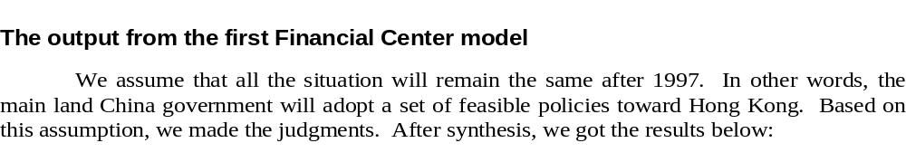
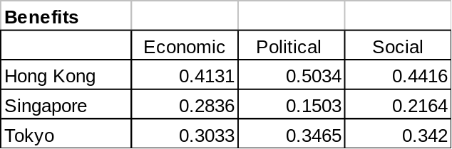
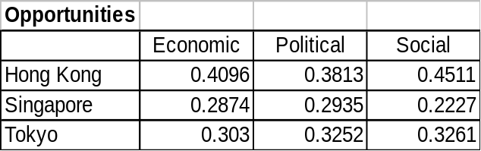
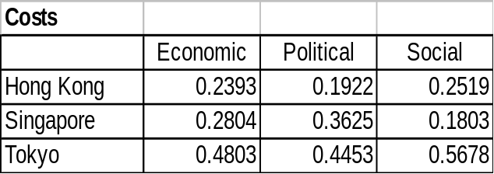
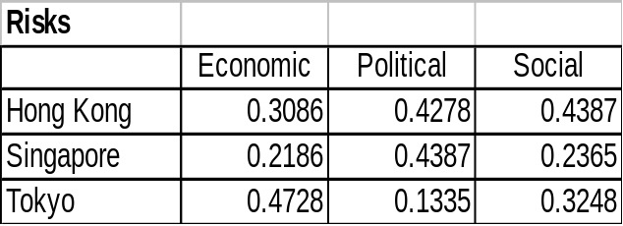
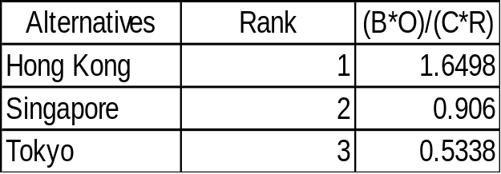
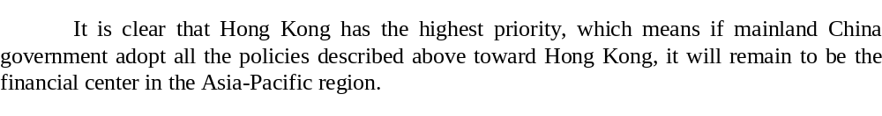

Slide 77
Likely Policies Followed by China
Affecting the Future of Hong Kong
About 50 potential Chinese policies were identified and ranked in a hierarchy. The most likely policies were identified and the network sub-models were re-assessed given this information. The hierarchy and the policies are shown next.

Slide 78
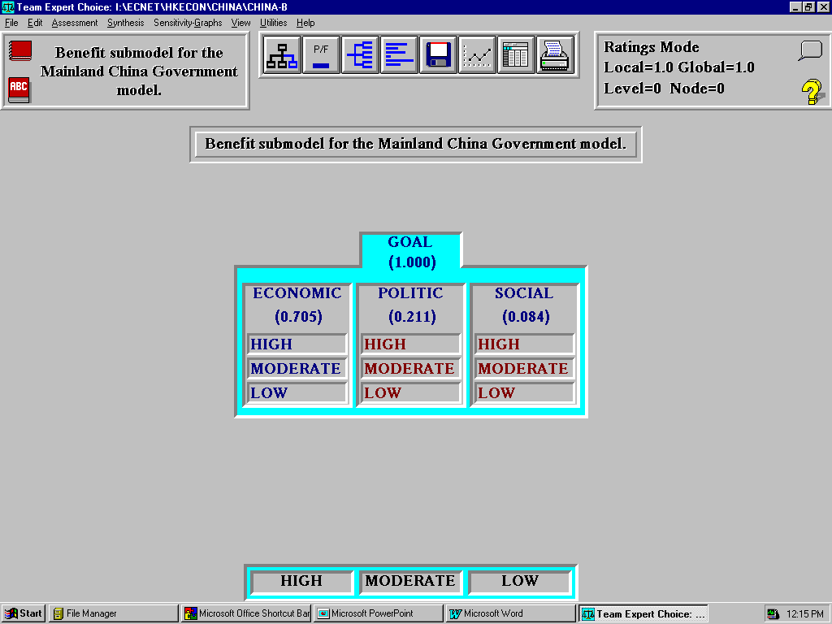
Sample Hierarchy for Assessing Benefit Intensities

Slide 79
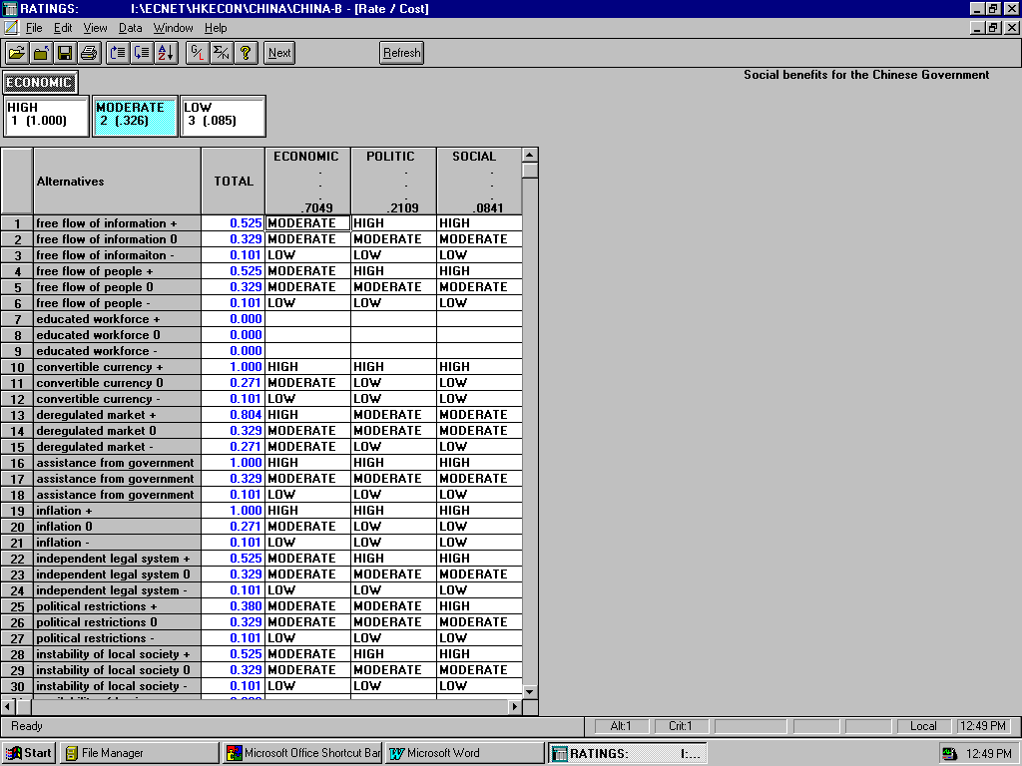
Policy Rating

Slide 80
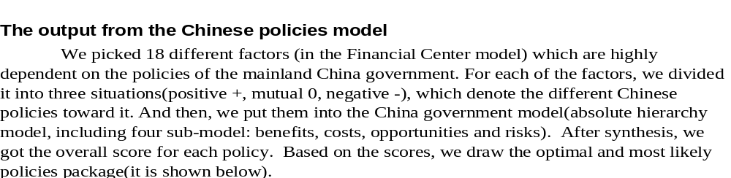
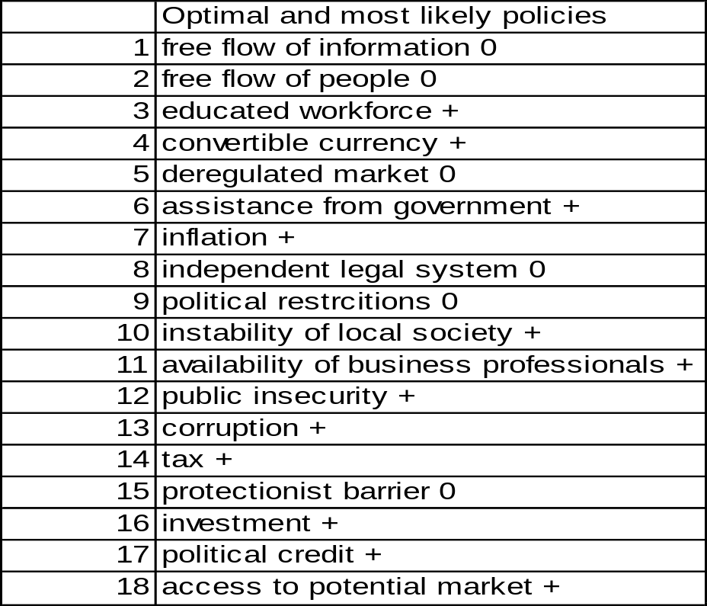

Slide 81
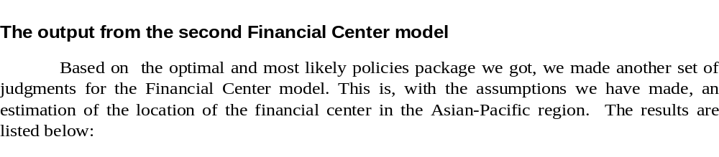
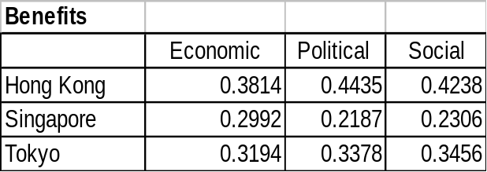





Slide 82

Original Economic Benefits Sub-Model Supermatrix
(Truncated to save space)

Slide 83

Weighted Economic Benefits Sub-Model Supermatrix
(Truncated to save space)

Slide 84

Limiting Economic Benefits Sub-Model Supermatrix
(Truncated to save space)

Slide 85

Normalized by Cluster - Results from Limiting
Economic Benefits Sub-Model Supermatrix

Slide 86
The Result
The first result from the Financial Center model:
If the Chinese government is able to maintain the current status of Hong Kong, Hong Kong would still be the Financial Center is the Asia-Pacific region in 2000.
The first result from the Mainland China Policy model:
For interests of the mainland Chinese government, no negative policy should be adopted towards Hong Kong after 1997. A careful and sensitive approach towards the future Hong Kong policy is suggested by this result, which is also reinforced by the next result.
The second result from the Financial Center model:
Although Hong Kong may still be the best choice for a Financial Center, Singapore will become a strong competitor for the Center in 2000.

Slide 87
Conclusions
1) Based on the first output of our Financial Center model, we can see that if all conditions remain the same, in other words, if China adopts all the positive policies toward Hong Kong, in other words if the Chinese government is able to maintain or even improve the current status of Hong Kong, it is quite sure that Hong Kong will remain one of the important financial centers in the Asia-Pacific region.
2) Among the influencing factors of the financial center status, many of them are dependent directly on the government’s policies. Therefore, Hong Kong’s future as a financial center is highly dependent on the political attitude of the Chinese government.
3) Based on the result of our mainland China policy model, we found, among the 18 factors, the Chinese government should adopt positive policies on 12 of them, and mixed policies on 6 of them. In other words, for the interests of China itself (not Hong Kong), China should avoid implementing negative policies, as defined in this study towards Hong Kong as a financial center.
4) Based on the second output of the Financial Center model, Hong Kong will maintain its financial status after 1997. But at the same time, Singapore will become very competitive. Therefore, our conclusion is that if Chinese government adopts rational policies toward Hong Kong as estimated in this study, Hong Kong will remain the number one financial center of the Asian-Pacific region. But at the same time, the position of Hong Kong as a financial center will be weakened. If any negative policies are implemented, Singapore will become the number one financial center of this Asia-Pacific region followed by Hong Kong.

Slide 88
Feedback Measurement as the Limiting Power of the Supermatrix
The eigenvectors of the paired comparison matrices are each part of a column of the supermatrix. The supermatrix may not be column stochastic. Its column blocks would be weighted by the priorities of the clusters to render the matrix stochastic. The supermatrix must now be raised to powers to capture all the interactions and feedback among its elements. What is desired is its limiting power
limW ^{k}
k 
The power of a matrix is function of that matrix. Entire functions (series expansion converges for all values) of a matrix can be represented by the formula:
n
II(λ_{j}I-W)
j≠i
II(λ_{j}-λ_{i})
j≠i

^{k}
^{i}
W^{k} =
λ
i=1
n
II (λ- λ_{i})
i=1
n
II (λ- λ_{i})
i=m_{i+1}
if the eigenvalues are distinct, or if they are not then by:
m
1 d ^{mi-1}
(m_{i}-1)! d λ^{mi-1}
W^{k} =

λ^{k}_{i} (λI-W)⁻¹
i=1
λ = λ_{i}
One is the largest eigenvalue of a stochastic matrix. This follows from
n
j=1
λ _{max} ⬄
max
i

a_{ij}
and the sum on the right is equal to the one for a column stochastic matrix. It is obvious that the moduli of the remaining eigenvalues of a stochastic matrix are less than or equal to one.
One is a simple eigenvalue if the matrix is positive. It can be a multiple eigenvalue or there may be other eigenvalues whose moduli are equal to one if there is a sufficient number of zeros in the matrix so that it is reducible. When the supermatrix has some zero entries, it may be that some power of it is positive and hence the matrix remains positive for still larger powers and is called primitive.
One is a simple eigenvalue of a primitive matrix. One may be a simple eigenvalue whether the matrix is primitive or not or a multiple eigenvalue yet there may not be other eigenvalues whose moduli is equal to one. The powers take on a certain form in the limit for each of these three cases. On the other hand if there are other such roots whose module is one, the powers of the supermatrix would cycle with a period of cyclicity and the limit is given by the same expression in all three cases namely when the supermatrix is imprimitive or when one is a simple or a multiple eigenvalue.

Slide 89


Slide 90


Slide 91


Slide 92

ANP PROJECTS

Slide 93

ANP REFERENCES cont’d

